Slide 1
Perditions of strokes
ISE-291 Project
Team: 2
_{HAYDER ALEISSA 202020460}
_{YASIR ALQAHTANI 201820720}
_{ABDULAZIZ ALOTAIBI 202132730}
_{MOHAMMED ALHUSINI 202029480}
_{OMAR ALSHAHRANI 202040640}

Slide 2
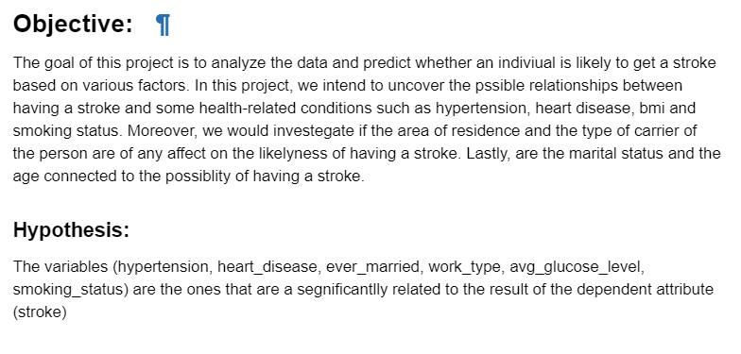

DISCOVERY
Source:

Slide 3
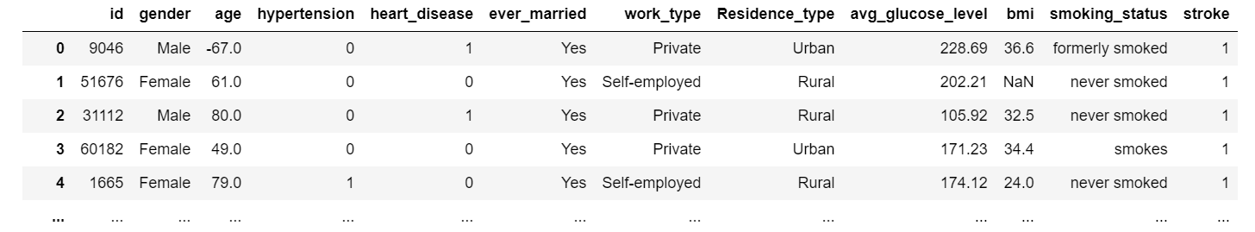
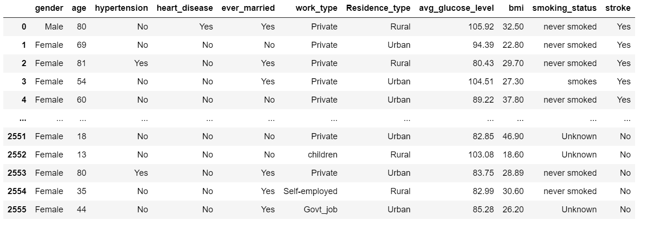
DATA PERPARATION
Before
cleaning
After
cleaning

Slide 4
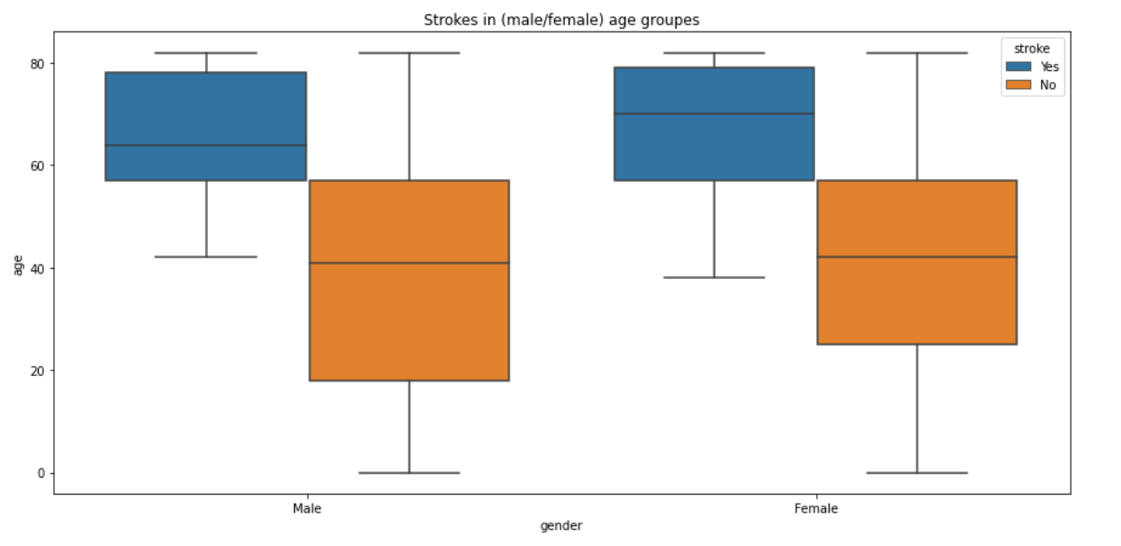
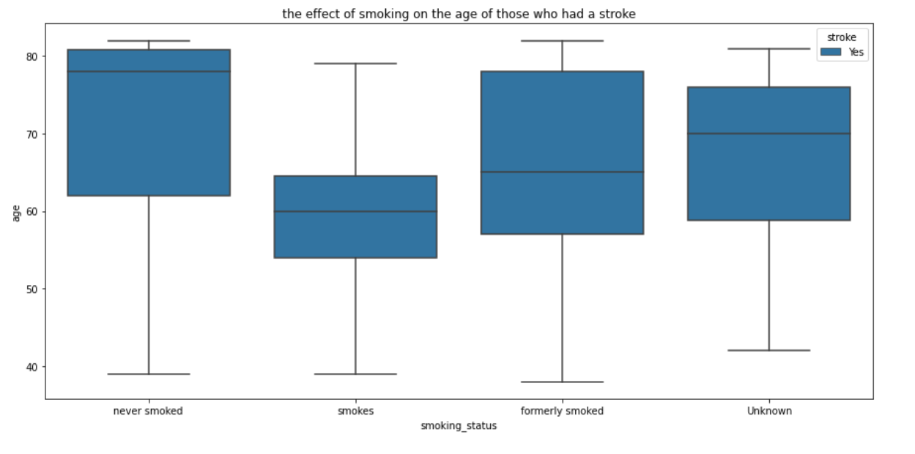
MODEL PLANNING

Slide 5
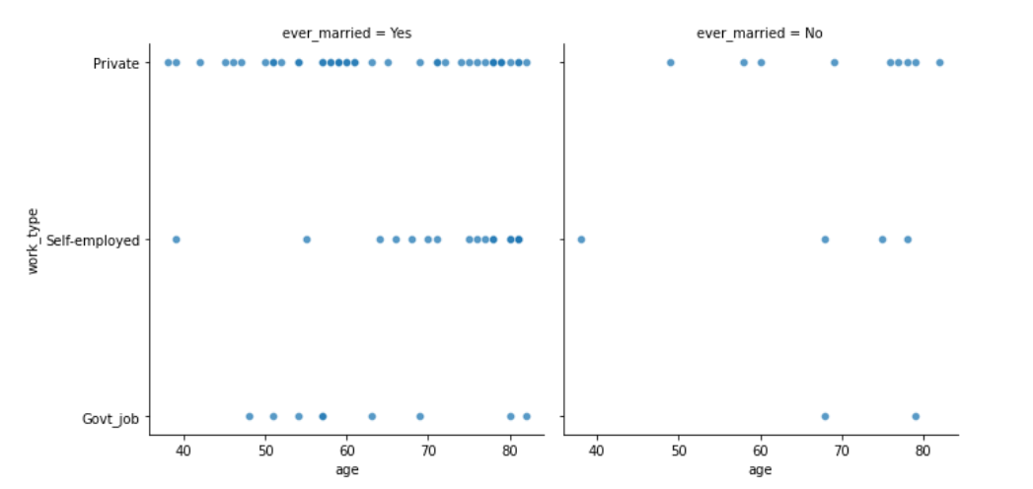
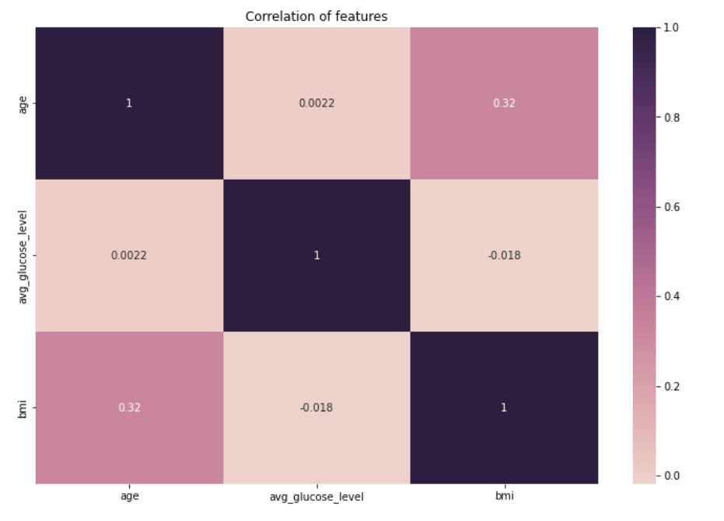
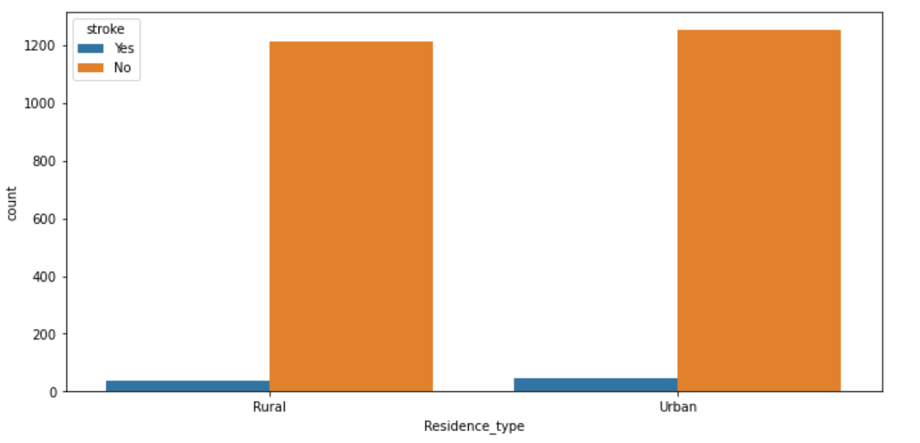

Slide 6
MODEL BUILDING
The ideal model : Classification models.
Reason: as our objective is to forecast whether a person will have a stroke or not, it is the ideal job for the classification models to draw this conclusion from the analyzed data after the training and the testing

Slide 7
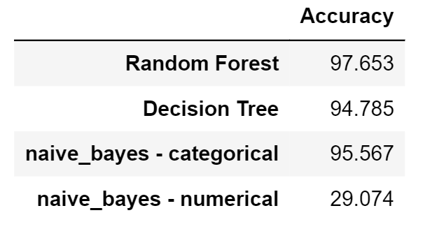
Data split
Training | Testing
70% | 30%

Slide 8
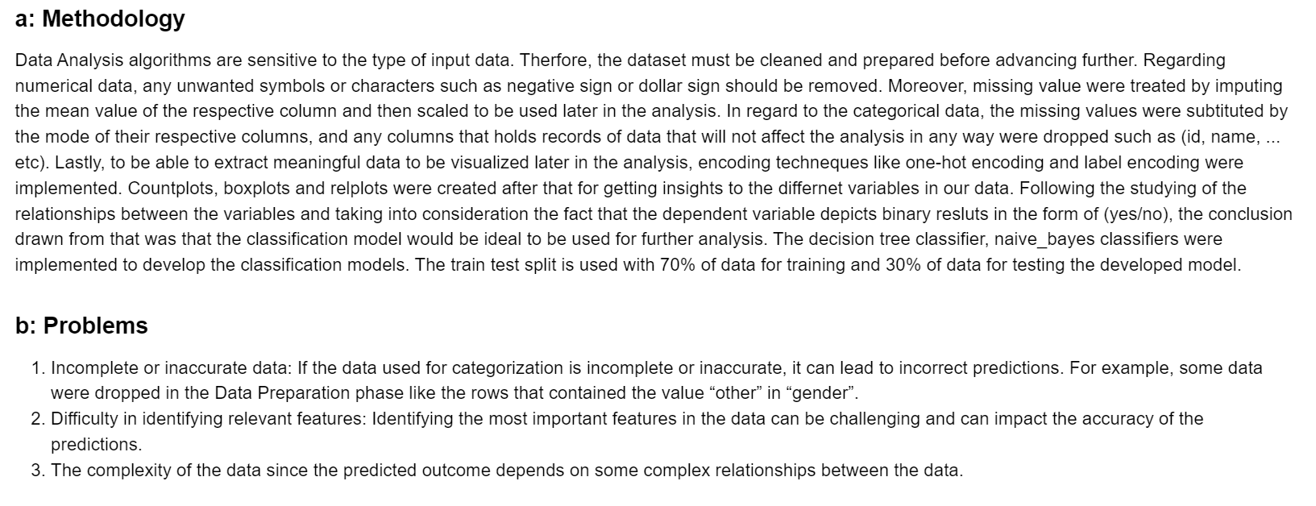
OPERATIONALIZE

Slide 9
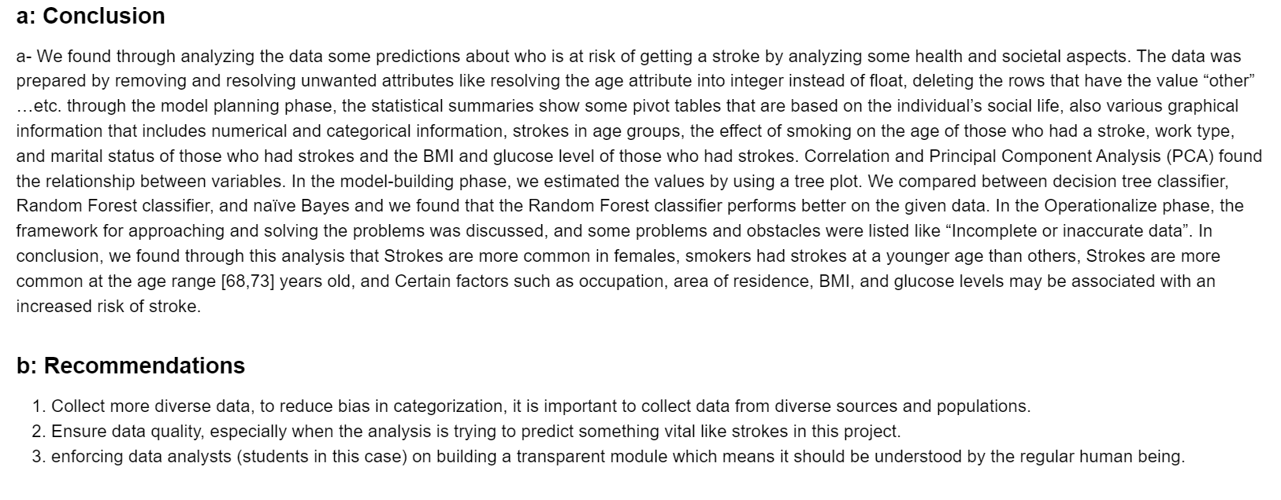
COMMUNICATE RESULTS

Slide 10
THANK YOU
&
GOOD LUCK

